Slide 1

Fiori@Bosch
SAP Fiori
Sabrina Li Sep. 2017
Confidential

Slide 2
Content
Introduction good UX & Fiori
SAP Fiori Design Principles
SAP Fiori Design Guideline
SAP Fiori 2.0
SAP Fiori Launchpad
Overview of Page Layout, Floorplans and Framework
Q&A
2

Slide 3
What is good UX?
A good user experience simplifies everything
-- the user interface (UI), the interaction, and
the functionality – and tailors them to seamlessly
to what you need and want for the tasks relevant
to your job.
https://videos.cdn.sap.com/vod/2015/ext/what-is-a-good-user-experience.mp4
Notes:
UI是UX里的一个小分支。 UI(User Interface)，是指用户界面，是视觉呈现来提高用户体验，使用户面对这个界面时操作更简单、更愉悦、更高效； UX(user experience)，就是指用户体验，单纯说用户体验是个很虚的词，我们不如说说哪些方面会影响到用户体验？ 用户使用产品（软件、硬件、电视、洗衣机等等都是产品）的目标是完成一个目标，就是去做一件事，每个人去做都希望：不要花太长时间、不要太复杂、不要让我想太多、不要弄得我不愉快、不要弄得我很紧张（焦虑）。反过来，影响这些因素的产品形态有：合理高效的流程、友好体贴的语言、操作容易理解、按键出现及时、界面舒适、不要太多无关内容影响（界面有效性）等等。 UI设计的过程，几乎渗透到UX的每一个节点，但更多的是去配合UX。比如一个界面，不考虑UX，也许UI做出来功能重点就不那么中肯。

Slide 4
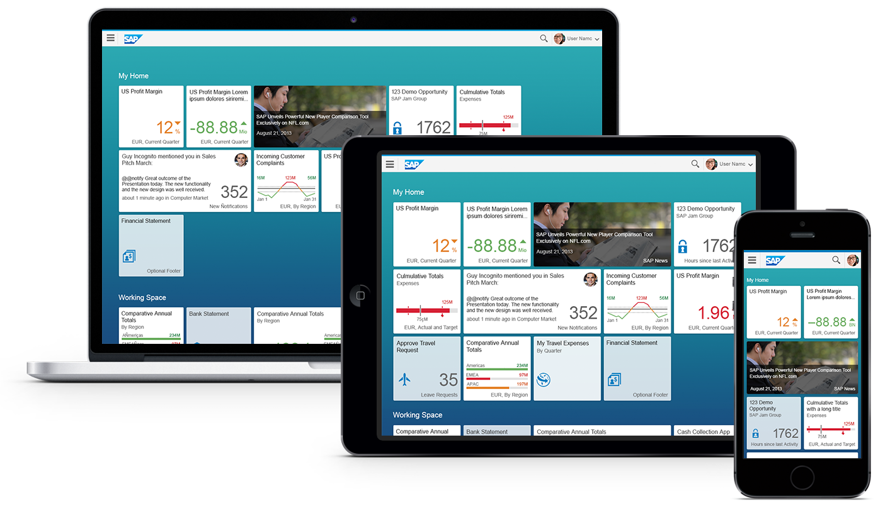
Introducing SAP Fiori Keeping Simple Things Simple
SAP Fiori is the new user experience (UX) for SAP software. It applies modern design principles for a completely reimagined user experience.
SAP Fiori UX is the new face of SAP to business users in all lines of business across devices and deployment options. It provides optimal usability for simplified business interactions and ease of use.
https://videos.cdn.sap.com/vod/2015/ext/what-is-sap-fiori.mp4

Slide 5
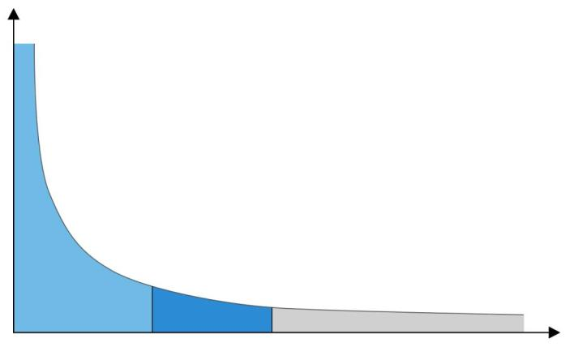
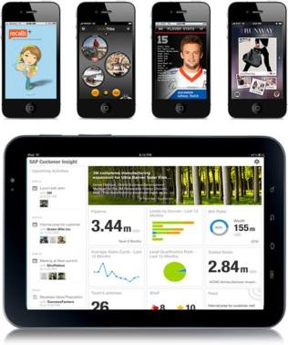
The SAP user experience strategy
New Applications
Existing Applications
SAP
Fiori
Top use scenarios
Usage/Reach
Core use
scenarios
Renovation
Enablement Tools (e.g. SAP Screen Personas)
Specific customer value
use scenarios
New
RENEW
ENABLE

Slide 6
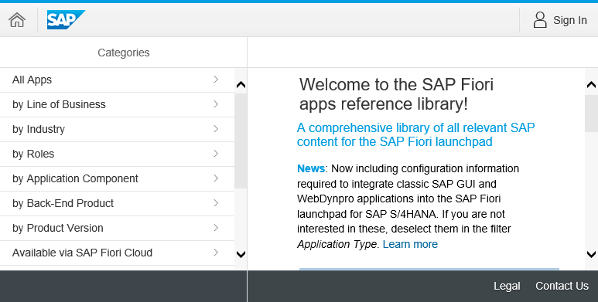
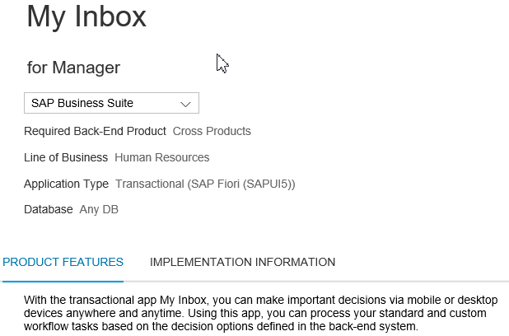

SAP Fiori App Library
General Information
User Role and LoB
Backend Requirements (HANA/AnyDB)
Search apps by various categories and filters
?
SAP Fiori App Library
Contain Information for ~11176 SAP Fiori apps and components (Feb/2019)
Product features
Key Features
Screenshots
Related apps
Implementation Information
Version History
Installation Details
Configuration & Customizing
Extensibility
Support (Notes & App Component)

Slide 7






SAP Fiori UX Design Principles
Role-based
Responsive
Simple
Coherent
Delightful
Designed for you, your needs and how you work
Supports how and where you work, at any time
Focuses on the important
Provides one fluid, seamless experience
Makes an emotional connection

Slide 8
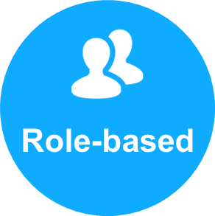
SAP Fiori UX Design Principles Role-Based
Role-Based
Design for what I do
Understand tasks I need to do and help me do it better
Use human tone to speak the language of my business
Build from insights within my business networks
Give me the information I need to complete my tasks
Bring together all information function the user needs independent of where it is stored
“Designed for People and How They Work”

Slide 9

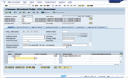
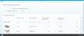
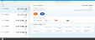
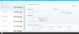
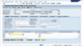
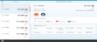
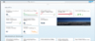
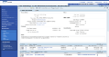
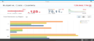
Fiori Apps Designed for Specific Roles Apps providing the right info for the right role
Functional-based applications
SAP Fiori Design Role-based applications
One transaction for multiple roles exposing all data & functions to all users
Decomposed apps for each role exposing only relevant data & functions
Multiple entry points for the user and inconsistent user experience (e.g. ERP vs. CRM)
One entry point for the user and UX following common design directions

Slide 10
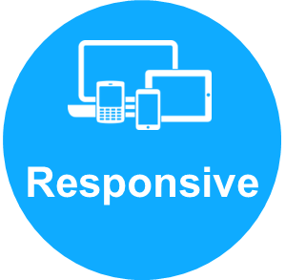
SAP Fiori UX Design Principles Responsive
Responsive
Support how and where I work
Deliver the best experience on any device used.
Feature smart adaptation where required.
React to who I am and what I do.
Take my point of view. Offer different perspectives within the same page.
“What you need, where you need it.”

Slide 11
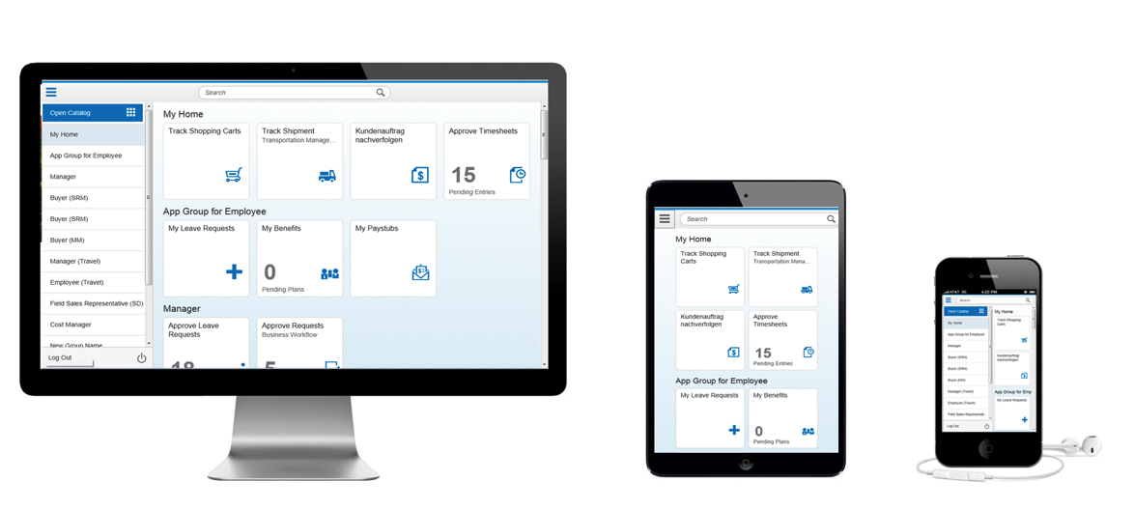
Responsive Web Design Seamless User Experience
Responsive design detects the user’s screen size and orientation to
change the layout accordingly to provide a consistent experience across devices
Benefits
Apps adapt and adjust automatically to the respective screen size based on the users device
Easy navigation and reading with a minimum of resizing, panning, and scrolling
Consistent experience across all device types

Slide 12
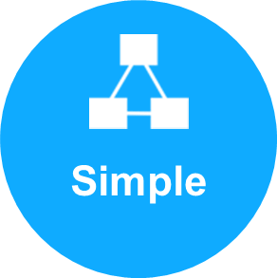
SAP Fiori UX Design Principles Simple
Simple
Powerful and efficient
Make essential functions obvious and easy to use.
To make SAP Fiori simple to match the user demand, SAP has designed it as a 1-1-3 scenario. This means 1 user, 1 use case and 3 screens.
“Focused on the important”

Slide 13
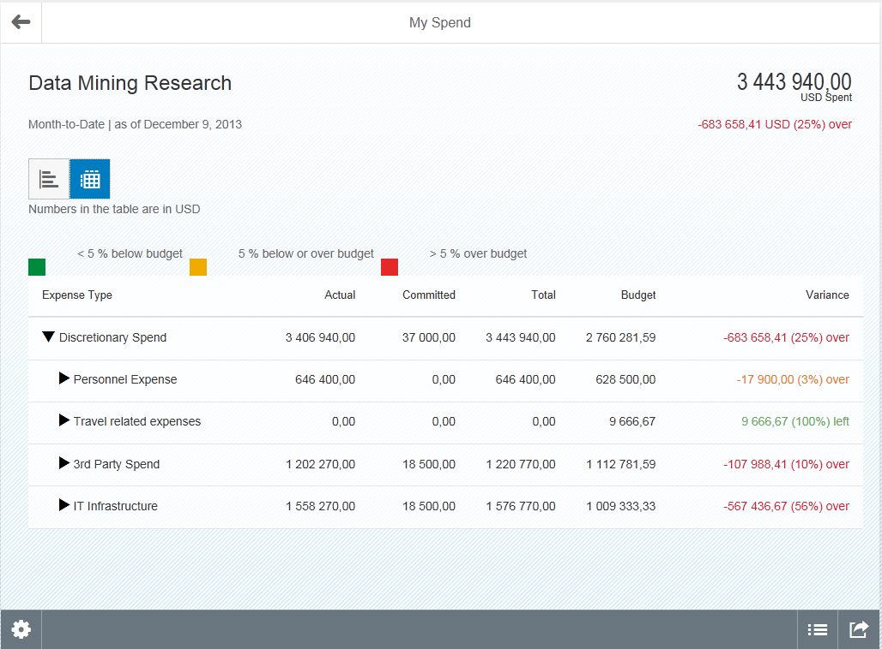
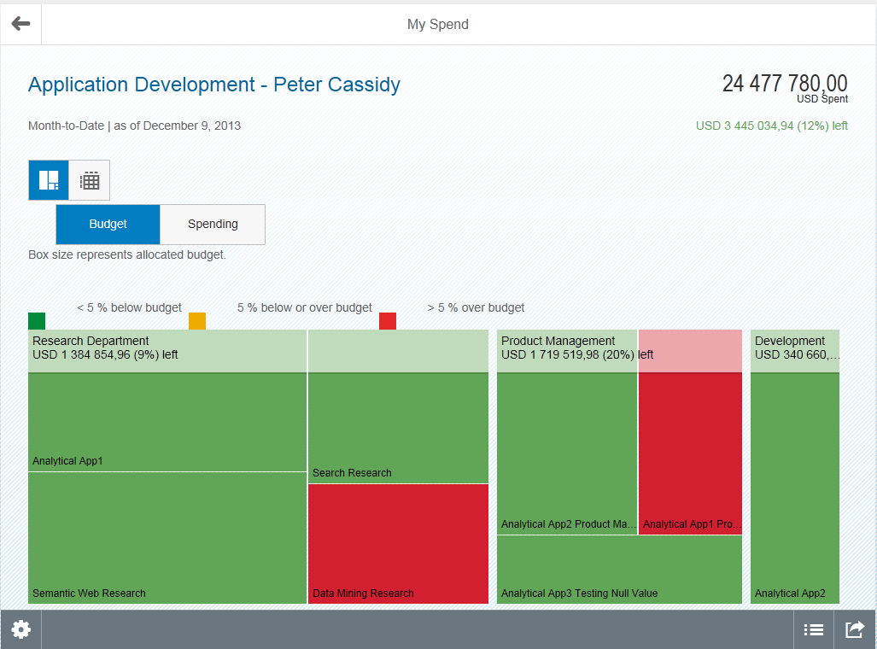
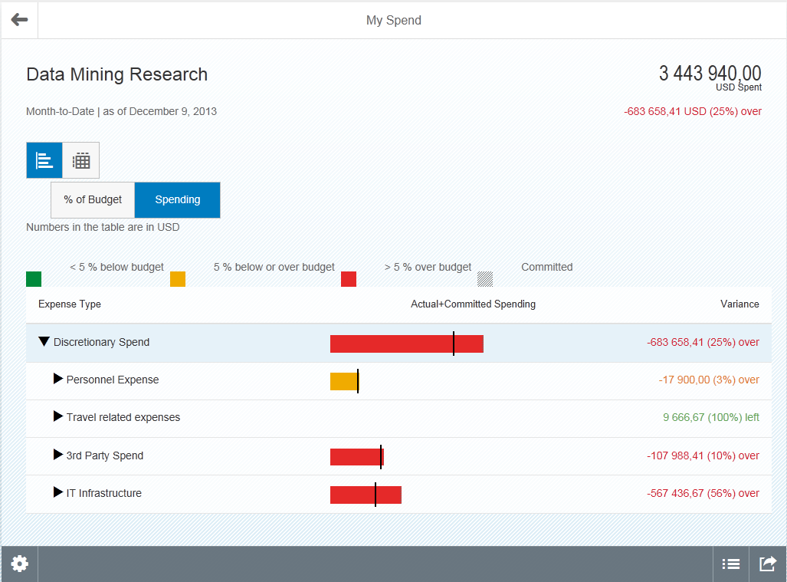
Fiori helps increase productivity: Adequate Context Information to make the Right Decision
Capabilities:
Adequate context information to make the right decision
Based on user research, SAP has determined which/ how much information is required to make decision
Drill down capabilities, analysis down to a detailed level
Benefits:
Enables user to take make decisions (approve/decline) without additional iterations or research
Enables user to take corrective measures in time

Slide 14

SAP Fiori UX Design Principles Coherent
Coherent
Build on what I know
All apps speak the same language.
Do the same thing in the same way everywhere.
Leverage my digital content; make it seamless.
Make the experience comfortable, familiar.
“One fluid experience”

Slide 15
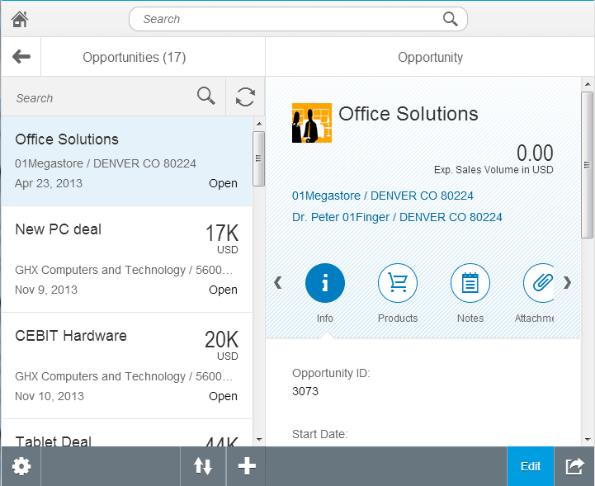
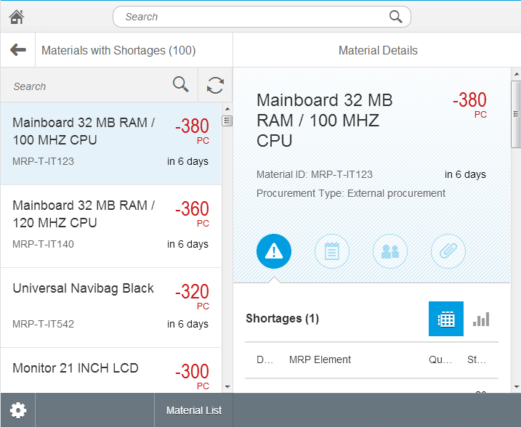
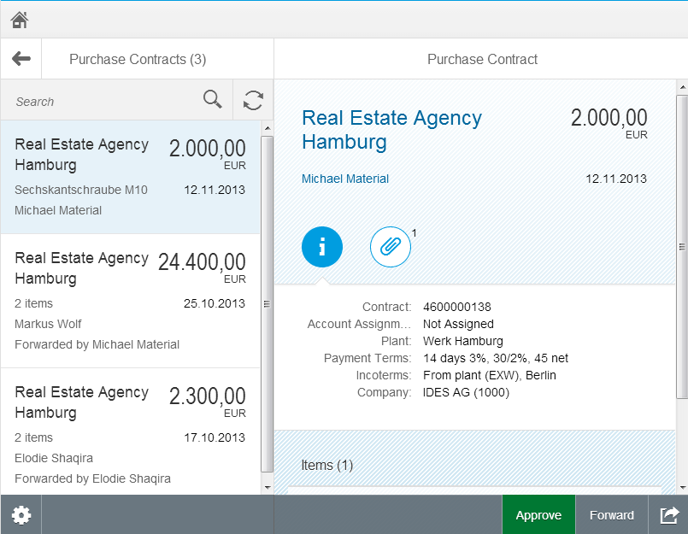
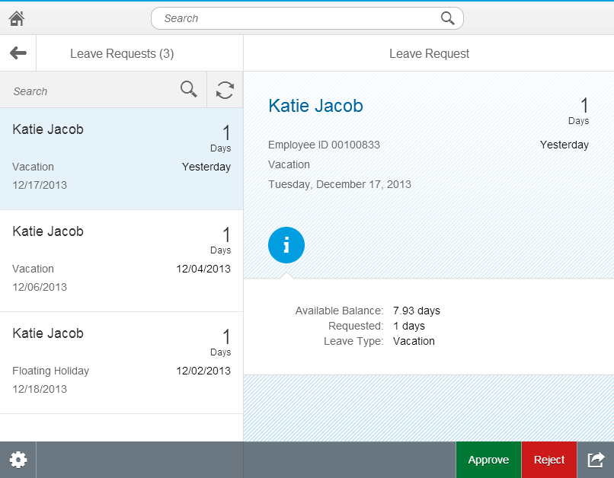
Fiori helps increase productivity: Consistent UI Across App
Sales
Capabilities:
Consistent experience across all apps, same structure, icons, etc.
Provides an optimal user experience across all device types
Benefits:
Users can switch across apps without effort
Accelerates task execution
Different Apps – Same Great Experience!!
Manufacturing
Purchasing
HCM
HCM Workflows

Slide 16

SAP Fiori UX Design Principles Delightful
Delightful
Make an emotional connection
Make me better at my job and feel like I’m an expert.
Show me the impact of my contribution.
Go beyond what’s expected; amaze me!
Be smart and proactive. Give me an assistant not just a tool.
“Beyond the expected”

Slide 17
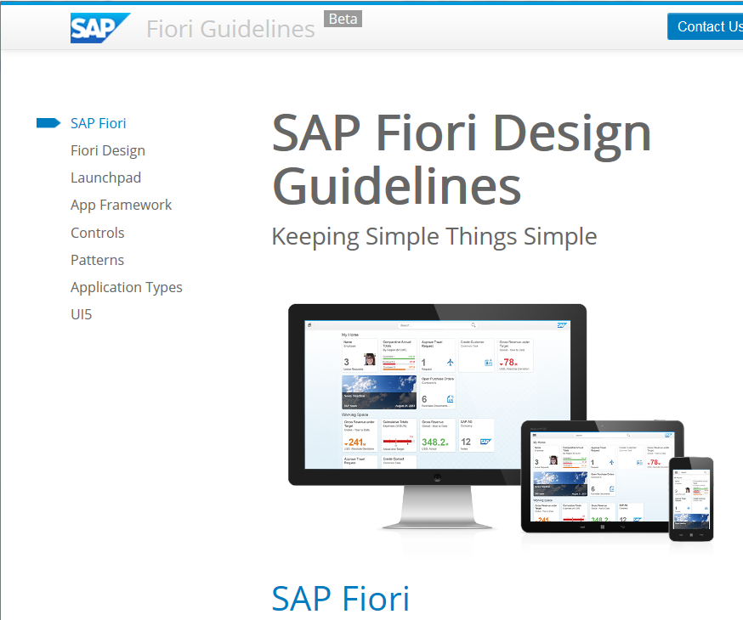
SAP Fiori Design Guidelines
Fiori Design
SAP Fiori focuses on a simple and consistent user experience on many devices. This section introduces the design philosophy which all SAP Fiori apps are based on.
Additionally, a prototyping kit provides you with templates for various controls and patterns. Using those stencils allows you to easily create UI mock-ups in Microsoft PowerPoint or Axure.
https://experience.sap.com/fiori-design-web/

Slide 18
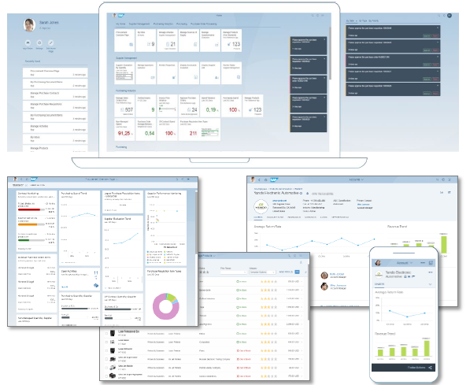
SAP Fiori 2.0
SAP Fiori 2.0 is the significant step in our evolution of user experience for business applications: an award-winning new design concept along with a delightful new visual theme, called Belize. SAP Fiori 2.0 is the user experience for SAP S/4HANA and other solutions.
Benefits
•Increased productivity –faster and direct access to relevant information and applications.
•Transparency on items needing your attention –timely notifications.
•Helps users decide what needs to be done next.
•Allows users to take quick and informed actions.
•Increased user satisfaction
Watch video of SAP Fiori 2.0 with SAP S/4HANA 1610

Slide 19
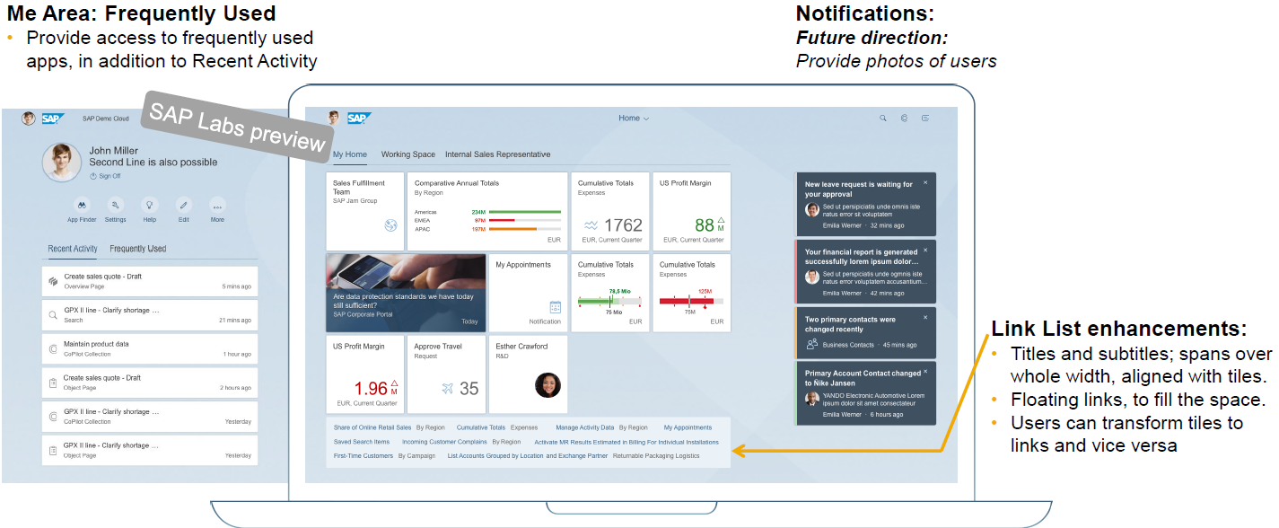
SAP Fiori Launchpad (1) Web-based entry point for SAP business applications across platforms and devices
SAP Fiori Launchpad is a role based,
personalized, real-time, and contextual
aggregation point for business applications
and analytics.
It runs on multiple devices, using
responsive web design, and is
deployable on multiple platforms.

Slide 20
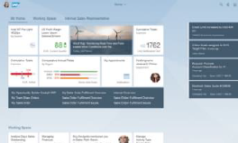
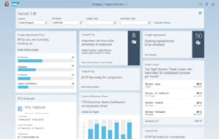
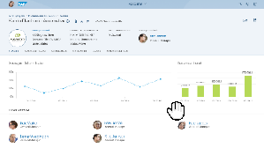
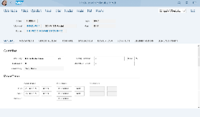
Single point of entry for Business User
Infos & Actions for user flow
* Overview Page: Minimum SAP Release SAP NW 7.50
Capture details and work in depth
SAP Fiori
Visually harmonized

Slide 21
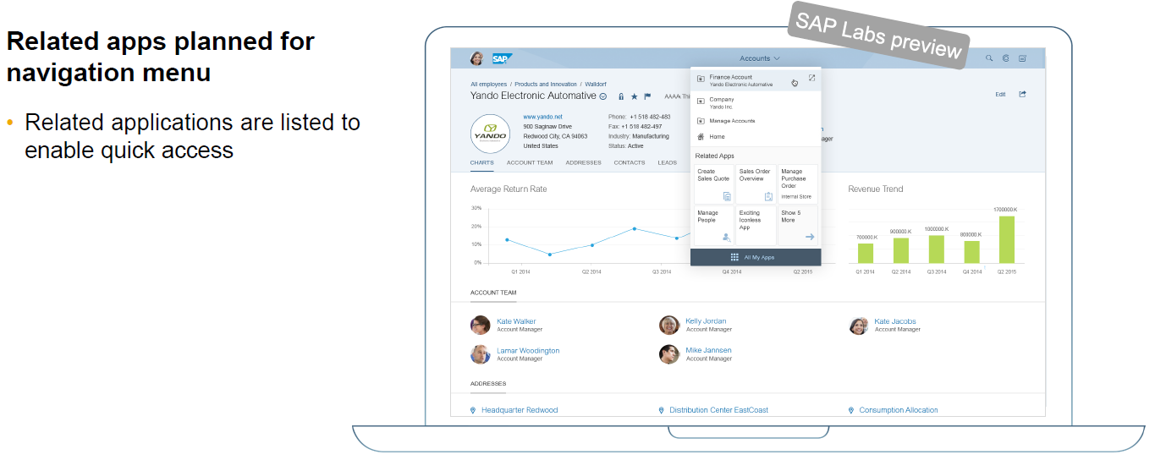
SAP Fiori Launchpad (2)
Navigation Menu

Slide 22
Overview of Page Layouts
Dynamic Page Layout
Full Screen Layout
Flexible Column Layout
Split-Screen Layout
Dynamic Side Content
Multi-Instance Handling

Slide 23
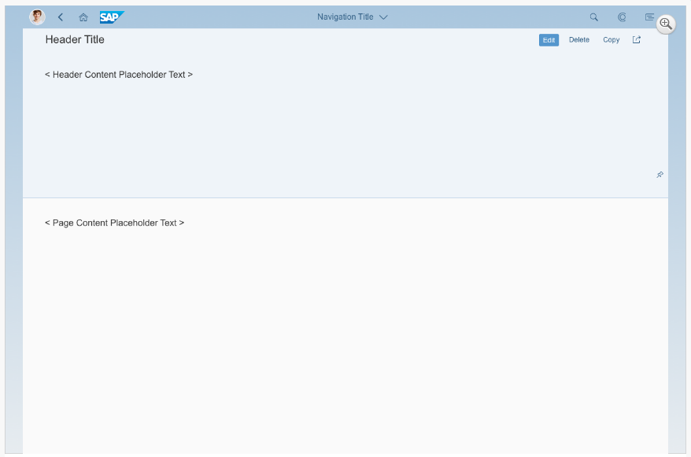
Overview of Page Layouts: Dynamic Page Layout
The dynamic page is a new layout control and it is designed in a way to support various floorplans and use cases. The layout is full responsive and will be the successor of the full screen layout with additional functionality to have a coherent and consistent snapping header concept that can be adapted throughout all floorplans.

Slide 24
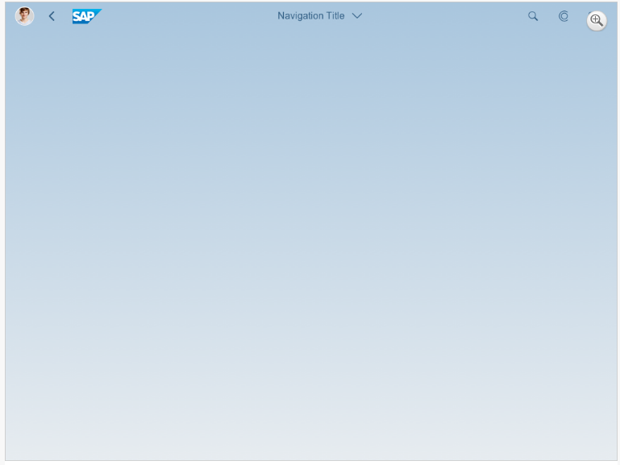
Overview of Page Layouts: Full Screen Layout
The full screen layout uses the full width of the screen to display the app content. This layout provides maximum flexibility while maintaining the look and feel of SAP Fiori. The full screen layout is ideal for displaying wide tables with four or more columns, and for showing various types of information on one page. However, it is difficult to ensure that the layout is responsive due to the immense differences between a widescreen desktop and a mobile phone.
Note: The full screen layout were deprecated with version 1.48.

Slide 25
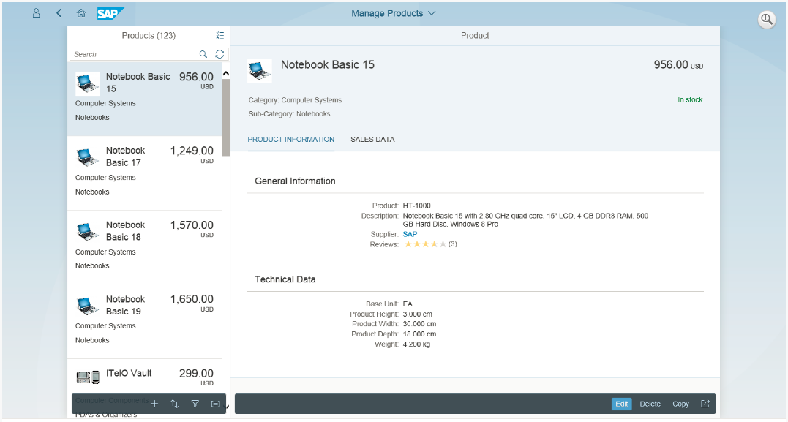
Overview of Page Layouts: Split-Screen Layout
The split-screen layout is one of the most widely used and stable layouts in SAP Fiori. Use this layout if the user needs to switch easily between different work items.
Note: The split screen layout were deprecated with version 1.48.

Slide 26
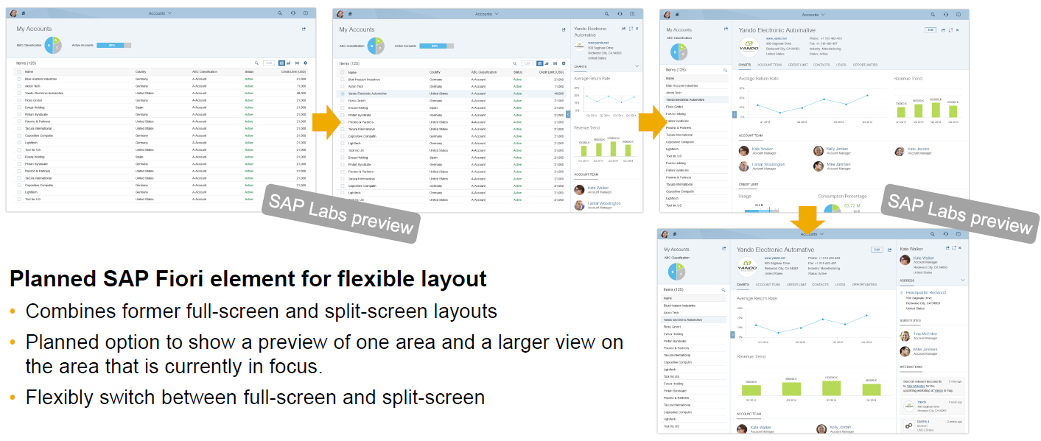
Overview of Page Layouts: Flexible Column Layout

Slide 27
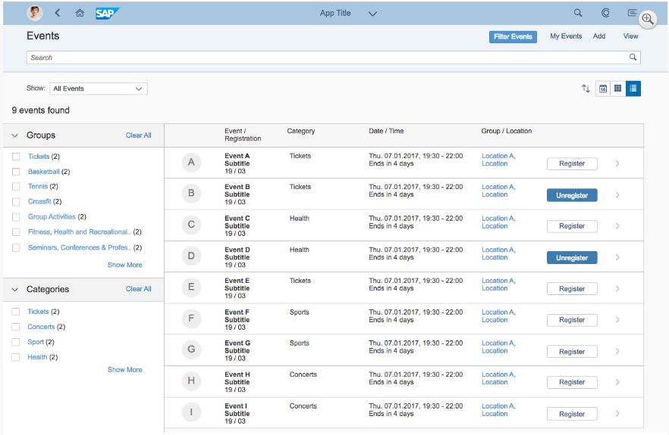
Overview of Page Layouts: Dynamic Side Content
The dynamic side content layout is a control that allows additional content – such as a timeline, chat, and additional information – to be displayed in a way that flexibly adapts to different screen sizes. The behavior of the control on smaller screen sizes can be configured by app development following the guidelines.

Slide 28
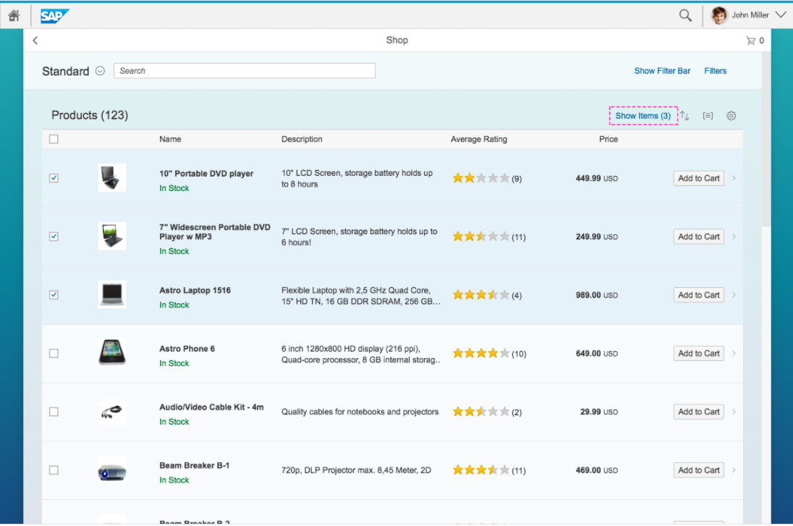
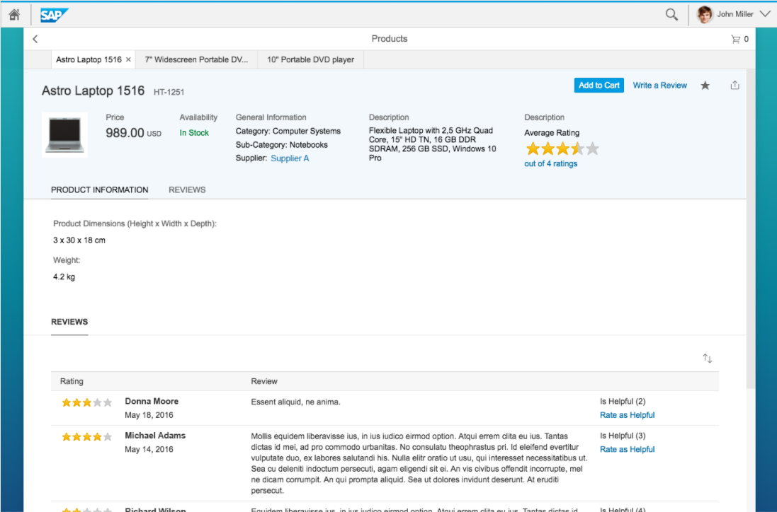
Overview of Page Layout: Multi-Instance Layout
The multi-instance layout allows users to open multiple documents in a tabular view. After selecting items from a list, the user opens them in a tab container.

Slide 29
Overview of Floorplans
Object Page Floorplan
Initial Page Floorplan
List Report Floorplan
Worklist Floorplan
Wizard Floorplan
Analytical List Page Floorplan
Object View Floorplan
Notes:
Layout是control，是布局，而floorplan是平面图

Slide 30
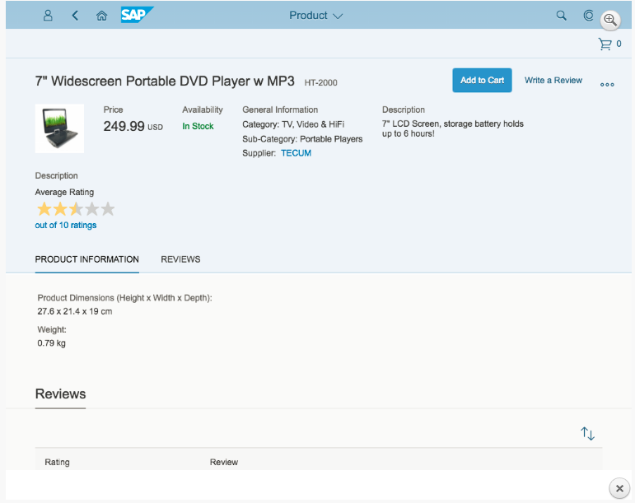
Overview of Floorplans: Object Page Floorplan
The object page floorplan is the new way to represent objects in SAP Fiori. The object page replaced the flat object view floorplan and the object view floorplan. New features in the object page, such as flexible headers, an alternative anchor, tab navigation, and a flexible responsive layout, enable you to adapt it for a wide range of use cases.

Slide 31
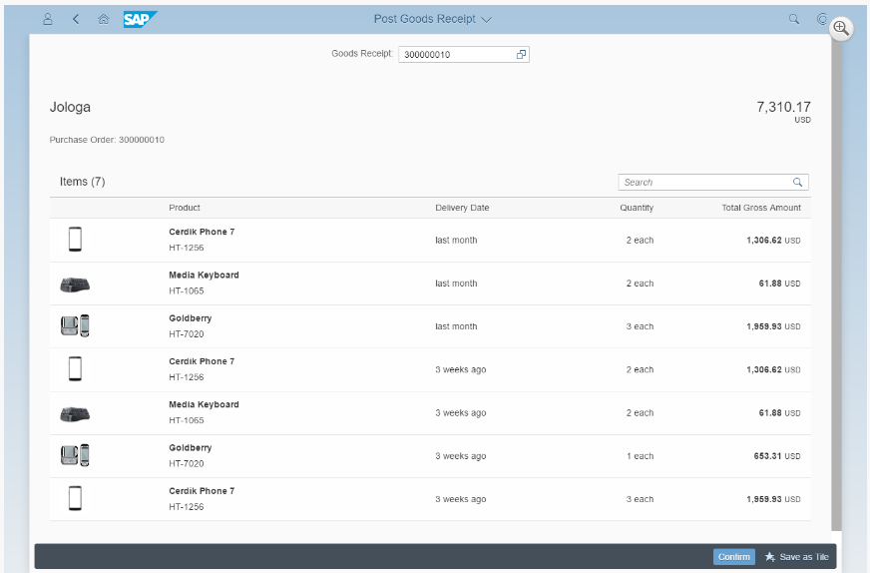
Overview of Floorplans: Initial Page Floorplan
Use the initial page floorplan if the user has to navigate directly to one object to view or edit it. The interaction point on the screen is a single input field that relies on assisted input to direct the user to the object in as few steps as possible (for example, value help and search as you type). If you need to display more than one object, use the list report floorplan instead.

Slide 32
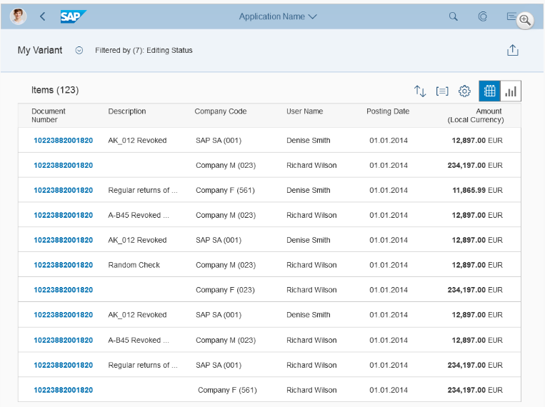
Overview of Floorplans: List Report Floorplan
The list report floorplan allows the user to work with large lists of items and take action. This floorplan combines powerful filtering capabilities for large amounts of data with diverse and useful ways to display the resulting item list.
Notes:
Users need to find and act on relevant items out of a large set of items by searching, filtering, sorting, and grouping.

Slide 33
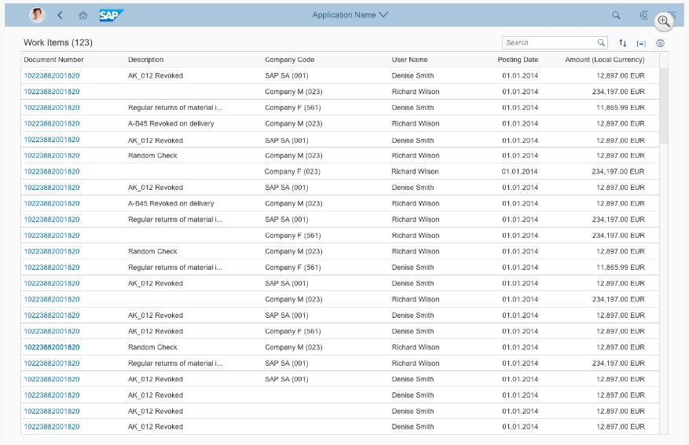
Overview of Floorplans: Worklist Floorplan
The worklist floorplan displays a collection of items to be processed by the user. Working through the item list usually involves reviewing details of the list items and taking action. In general, the user has to either complete a work item or delegate it.
The focus of the worklist floorplan lies on processing the items. This differs from the list report floorplan, which focuses on filtering content to create a list.
Notes:
Users need to work off a comparably small set of items, one by one. Use the work list floorplan instead.
A worklist displays a collection of items that are to be processed by the user. Working through the item list usually involves reviewing details of the list items and taking action. In most cases, the user has to either complete a work item or delegate it.
The focus of the worklist floorplan lies on processing the items. This differs from the list report floorplan, which focuses on filtering content to create a list.

Slide 34
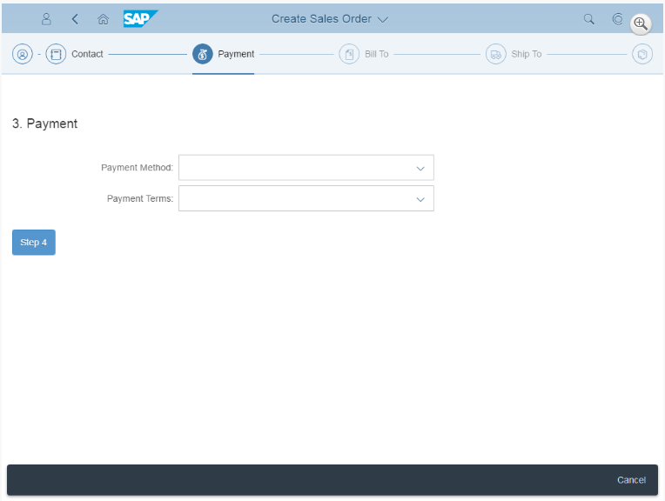
Overview of Floorplans: Wizard Floorplan
The wizard floorplan guides users through long and/or unfamiliar tasks by dividing the task into sections and guiding the users through the different sections. The wizard comprises a walk-through screen, where the form sections are sequentially revealed as they are completed, and a summary page, where the form is displayed in read-only mode for assessment and final submission. This floorplan can be used in both full screen and split screen layouts.

Slide 35
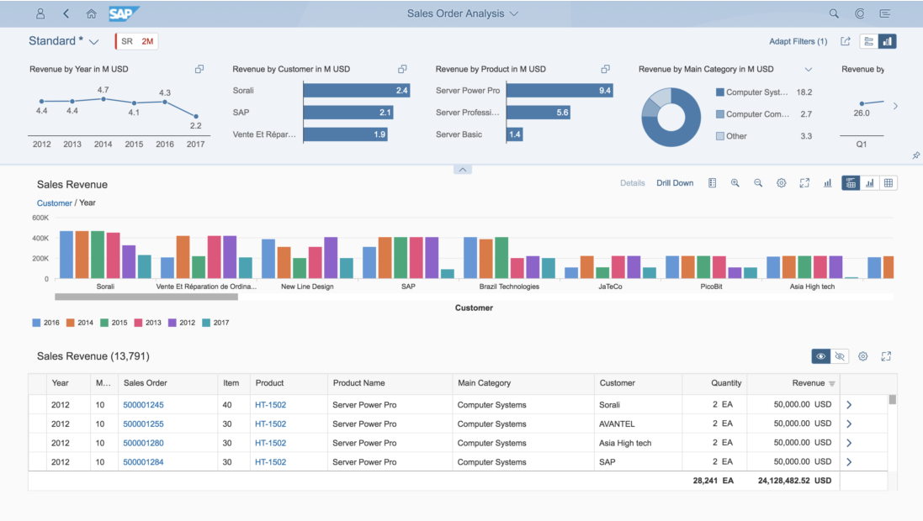
Overview of Floorplans: Analytical List Page Floorplan
The analytical list page offers dynamic data visualization and business intelligence capabilities that enable users to analyze data step by step from different perspectives. Users can drill down to investigate a root cause, and act on transactional content.

Slide 36
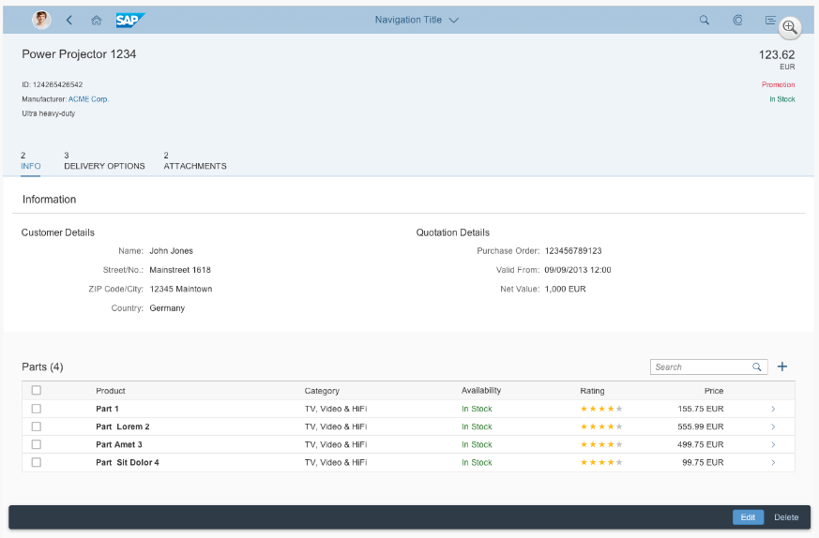
Overview of Floorplans: Object View Floorplan
The object view floorplan was the original floorplan used to display simple objects in SAP Fiori. It has since been replaced by the more comprehensive object page floorplan.

Slide 37
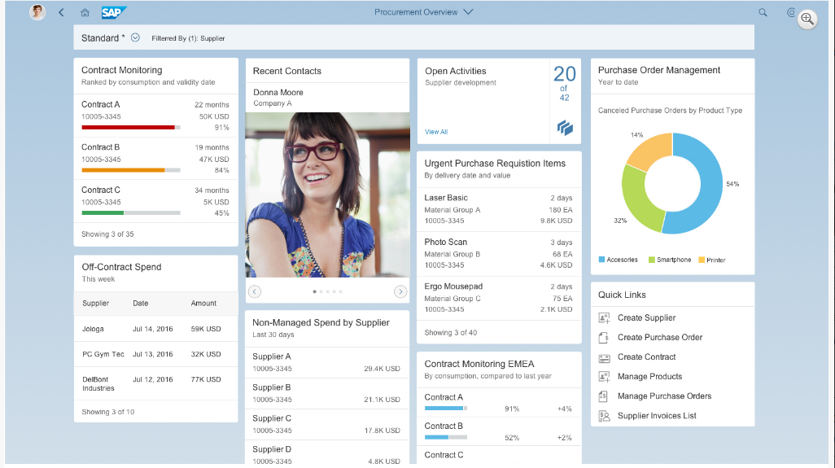
Overview of SAP Fiori Elements (1)
List Report
Object Page
Worklist
Overview Page
Based on a specific domain or role, the overview page (OVP) is a new data-driven SAP Fiori app that provides all the information a user needs to view, filter, and react to data in a one-stop-shop page. The OVP employs cards (containers of content) based on smart template technology as a UI framework for organizing large amounts of information on an equal plane within the page.
Notes:
SAP Fiori elements (formerly known as smart templates) provide a framework for generating UIs at runtime based on metadata annotations and predefined templates for the most used application patterns. reduce the amount of frontend code for building SAP Fiori apps
SAP Fiori elements use annotations that add semantics and structures to the data provided by the user.
SAP Fiori elements are part of the SAPUI5 delivery.
provides all the information a user needs in a single page, based on the user’s specific domain or role. It allows the user to focus on the most important tasks, and view, filter, and react to information quickly.

Slide 38
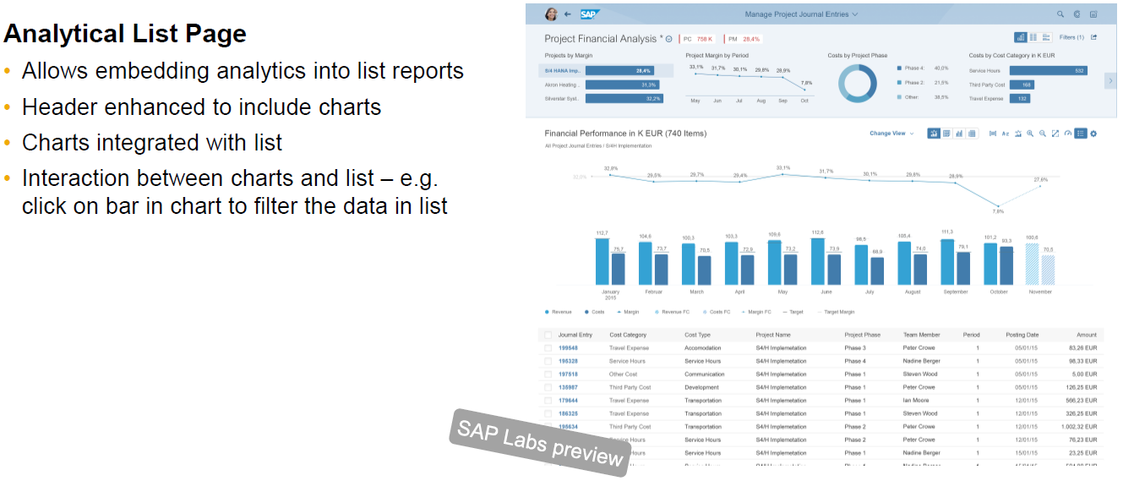
Overview of SAP Fiori Elements (2)
Notes:
The analytical list page offers a unique way to analyze data step by step from different perspectives, to investigate a root cause through drilldown and seamlessly take action on transactional content within one page.

Slide 39
Overview of Frameworks
Analysis Path Framework
SAP Smart Business Framework

Slide 40
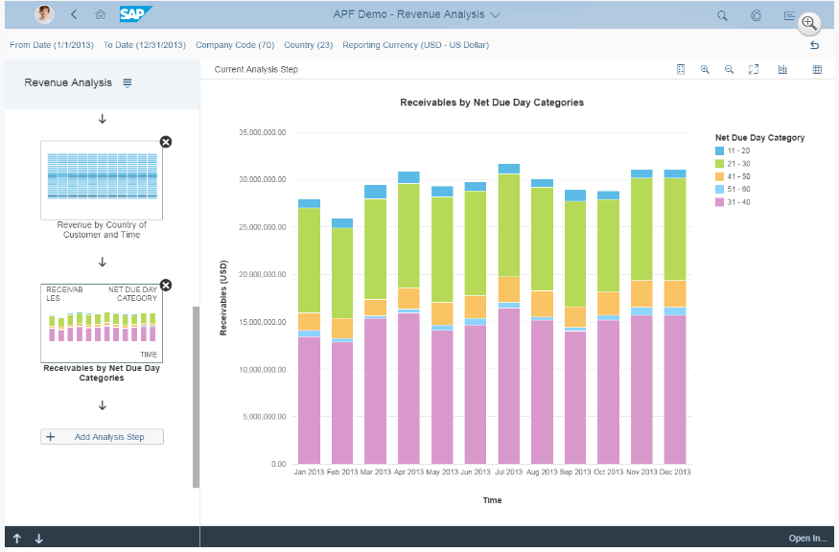
Overview of Frameworks: Analysis Path Framework
Analysis Path Framework (APF) is a framework for creating interactive, chart-oriented analytical drilldown apps by configuration. APF-based apps enable the user to view and analyze the data of several key performance indicators (KPIs) from different data sources. Users can interactively explore data step by step from different perspectives to analyze and investigate root causes.
https://help.sap.com/saphelp_uiaddon10/helpdata/en/4b/601d69a4874a7fb1353d9d5e01d97e/frameset.htm
Notes:
APF can consume OData services that are based on the following data sources:
Calculation views
ABAP CDS views
BW OData queries

Slide 41

Overview of Frameworks: SAP Smart Business Framework
SAP Smart Business drilldown is an analytical app. It enables the user to view and analyze the data of one key performance indicator (KPI).
https://help.sap.com/saphelp_uiaddon10/helpdata/en/4b/601d69a4874a7fb1353d9d5e01d97e/frameset.htm
Notes:
It enables the user to view and analyze the data of one key performance indicator (KPI)

Slide 42


Questions

Slide 43
Useful Information (1)
BASIC INFO ON FIORI
SAP User Experience Community:
https://experience.sap.com/
SAP UI5 Community:
https://www.sap.com/community/
Bosch Fiori Community:
https://connect.bosch.com/communities/service/html/communitystart?communityUuid=869bc3f5-5b8a-4c13-9089-55374cd632ca&successMessage=confirm.requesttojoin#
Fiori Design Guideline:
https://experience.sap.com/fiori-design-web/

Slide 44
Useful Information (2)
SAP Fiori App Library: https://fioriappslibrary.hana.ondemand.com/sap/fix/externalViewer/#
SAP Fiori Demo Cloud Edition https://www.sapfioritrial.com/
SAP Fiori Controls Explored: https://sapui5.netweaver.ondemand.com/sdk/explored.html
Design Tools:
https://experience.sap.com/fiori-design-web/downloads/

